Slide 1
Monarch Movement Model
September 30, 2015

Slide 2
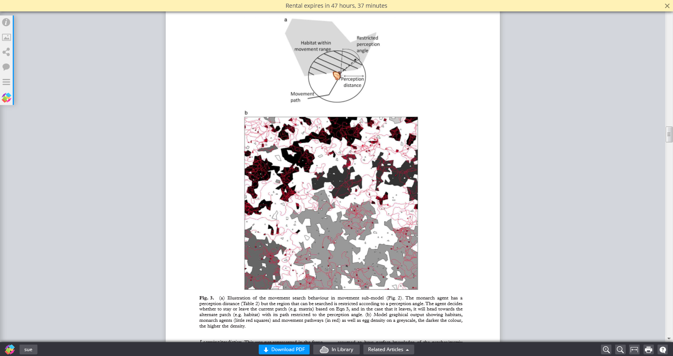
Overview

Slide 3
Movement Sub-Model

Slide 4
Egg-Laying Model

Slide 5
GIS Model of Story County

